Slide 1

Jake Vestal
Design and Testing of Algorithmic Trading Systems with Python
Class 4:
HW2 Launch Day!

Slide 2
MIDTERM
We’ll have a study session on 02 March and a midterm on 09 March.
I will give you a study guide that we’ll go over thoroughly at the review session.

Slide 3
HW2
We’ll go over blotters today and discuss:
Teams
Scope
Timing
Code
Of HW2.
This powerpoint will be edited and updated at the end of class, so no need to take photos/notes.

Slide 4
Basic Algo
Has parameters
Takes in data
Applies a model
Outputs a blotter

Slide 5
BLOTTER
Complete list of trade activity
Blotter is a dataframe for which:
Every row is a trade order – an action sent to your execution system telling it to do something (buy a stock, cancel an order, etc)
Has the following columns:
trade_id: unique numeric identifier for all orders pertaining to a particular trade
date: date (or datetime) on which the status was updated
asset: identifier of the thing you’re trading (e.g., “IVV”)
trip: “ENTRY” or “EXIT” for creating a new position vs. unwinding an existing one
action: “BUY” or “SELL” – the only two things you can do in a market.
price: the relevant price – look to ‘status’ for exact meaning (i.e., is it a filled price, an ask price, etc)
status: the state of the order on the date (or time) given by date. Possible values are: “SUBMITTED”, “FILLED”, “CANCELLED”, “LIVE”, and “MODIFIED”
params: additional parameters that might be necessary for special cases such as options exercise.

Slide 6
BLOTTER
Complete list of trade activity
The blotter is a complete characterization of a given trading strategy.
You can use it to:
Calculate the actual worth of your assets under management (AUM) over time
Calculate the expected return per trade, volatility, correlation of returns with other assets
Sell your algo services to investors – by sharing a blotter of trades you’ve made, maybe anonymizing it as appropriate, you can convince someone that you’re actually making the returns you’re claiming without giving away your trading strategy

Slide 7
BLOTTER
Something missing?
size: number of units (shares, contracts, etc) being traded.
This one is special, so we leave it for last.
As we’ve written it, our blotter is fine for calculating returns per trade, but by introducing the idea of size, we might put different weights on each trade.
Size probably depends somewhat on capital available at the time, which isn’t always solely a function of past trades
Also realize the blotter can be used to calculate a trade ledger in which each row is a trade –not an order – alongside relevant data. The trade ledger can be thought of as a set of input features for an ML or other analytical model. There are all sorts of questions you can train it to answer, but sizing is one of the most useful – put bigger orders on trades that are more likely to pay off sooner!

Slide 8
BLOTTER
We’ll deal with size in later steps.

Slide 9
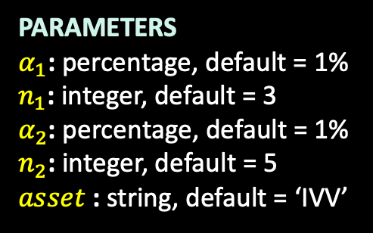
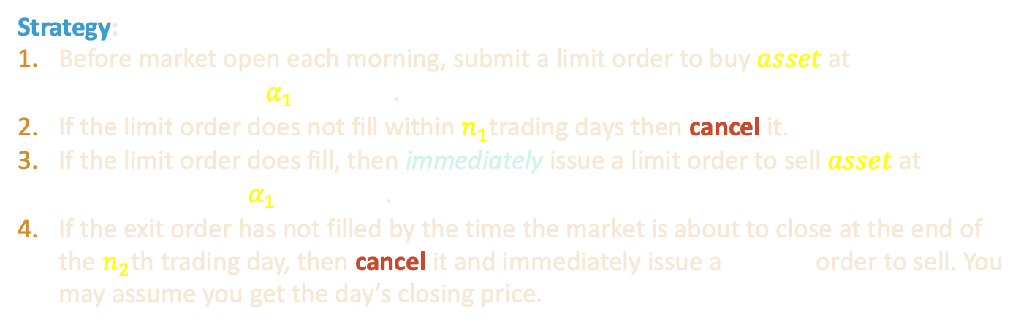
HW2: Framework
Create an interactive backtest in Dash for a simple strategy
PARAMETERS
$α_{1}$: percentage, default = 1%
$n_{1}$: integer, default = 3
$α_{2}\text{:}$ percentage, default = 1%
$n_{2}\text{:}$ integer, default = 5
$asset$ $\text{:}$ string, default = ‘IVV’
Strategy:
Before market open each morning, submit a limit order to buy $asset$at
${prc}_{entry}=\left(1+α_{1}\right){close}_{−1}$.
If the limit order does not fill within $n_{1}$trading days then cancel it.
If the limit order does fill, then immediately issue a limit order to sell $asset$ at
${prc}_{exit}=\left(1+α_{1}\right){prc}_{entry}$.
If the exit order has not filled by the time the market is about to close at the end of the $n_{2}$th trading day, then cancel it and immediately issue a market order to sell. You may assume you get the day’s closing price.
“yesterday’s closing price”

Slide 10
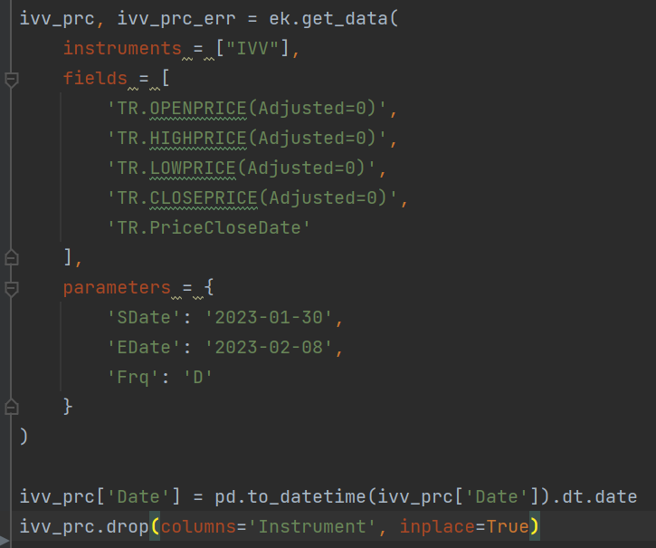
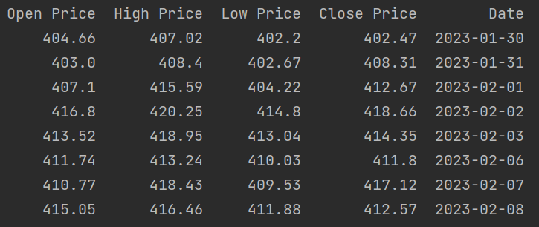
Fetching some Sample Data
ivv_prc: dataframe name in my code

Slide 11
Date subtlety
ivv_prc
In this example, we’re assuming that we’re running this after market close on 08 Feb, but before market open on 09 Feb.
Think of it as: “today” = the next business day after the last closing price we have (because if we had a later closing price… we’d use it! ☺)
You can assume that you wouldn’t run entry order scripts during market hours on a trading day because this strategy works by having those orders already submitted and ready to go when the market opens.

Slide 12
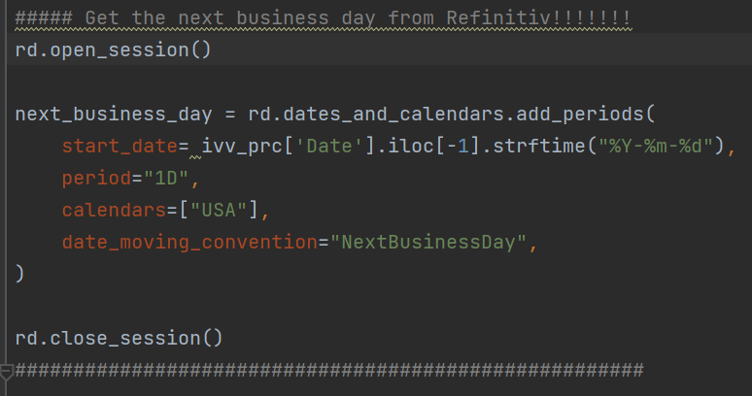
Getting the Next Business Day in Refinitiv

Slide 13
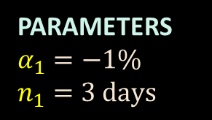
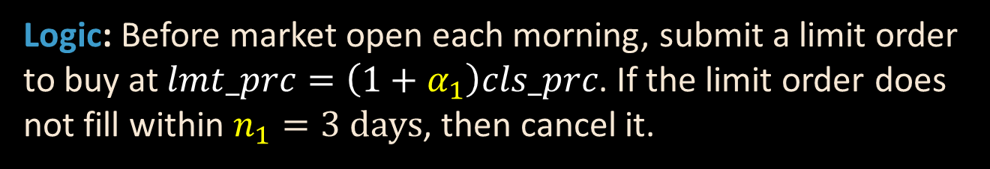
Making a blotter for an entry strategy
PARAMETERS
$$α_{1}=−1\%$$
$$n_{1}=3 \text{days}$$
Logic: Before market open each morning, submit a limit order to buy at $lmt_prc=\left(1+α_{1}\right)cls_prc$. If the limit order does not fill within $n_{1}=3 \text{days}$, then cancel it.

Slide 14
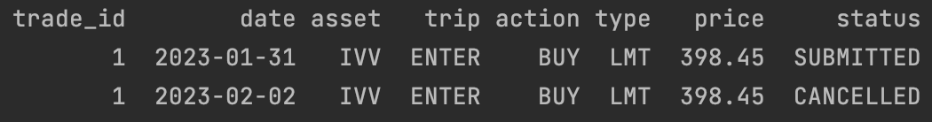
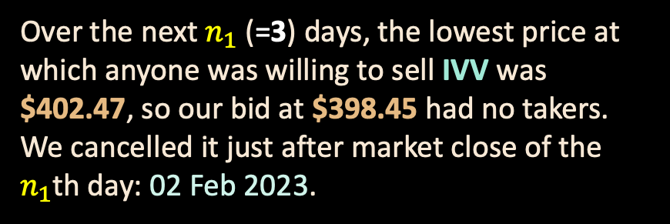
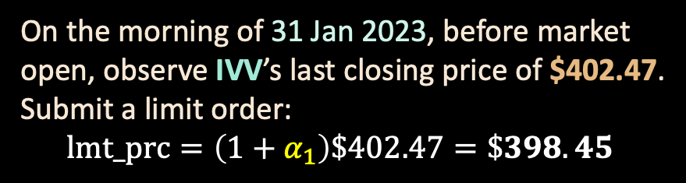
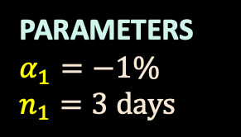
HW2: Example
Trade 1:
PARAMETERS
$$α_{1}=−1\%$$
$$n_{1}=3 \text{days}$$
On the morning of 31 Jan 2023, before market open, observe IVV’s last closing price of $402.47. Submit a limit order:
$$\text{lmt}\text{_}\text{prc}=\left(1+α_{1}\right)\$402.47=\$398.45$$
Over the next $n_{1}$(=3) days, the lowest price at which anyone was willing to sell IVV was $402.47, so our bid at $398.45 had no takers. We cancelled it just after market close of the $n_{1}$th day: 02 Feb 2023.
The blotter entries for Trade 1 would look like this

Slide 15
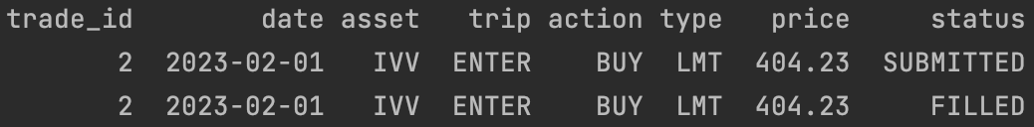
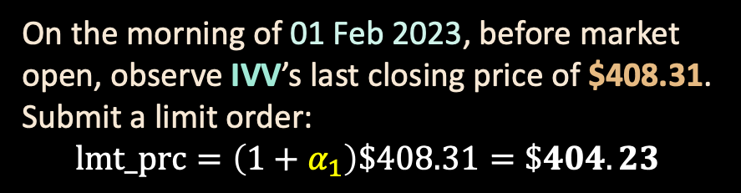
HW2: Example
Trade 2:
PARAMETERS
$$α_{1}=−1\%$$
$$n_{1}=3 \text{days}$$
On the morning of 01 Feb 2023, before market open, observe IVV’s last closing price of $408.31. Submit a limit order:
$$\text{lmt}\text{_}\text{prc}=\left(1+α_{1}\right)\$408.31=\$404.23$$
Somebody would have bought it later that same day because they were willing to sell it for $0.01 less than that, so we assume the order filled.
If it were a HUGE order though – large number of shares – that assumption is less good. Google “slippage in trading backtesting” to see why.
The blotter entries for Trade 2 would look like this

Slide 16
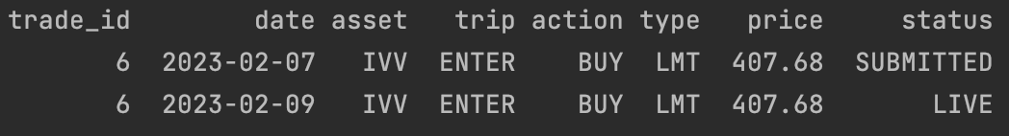
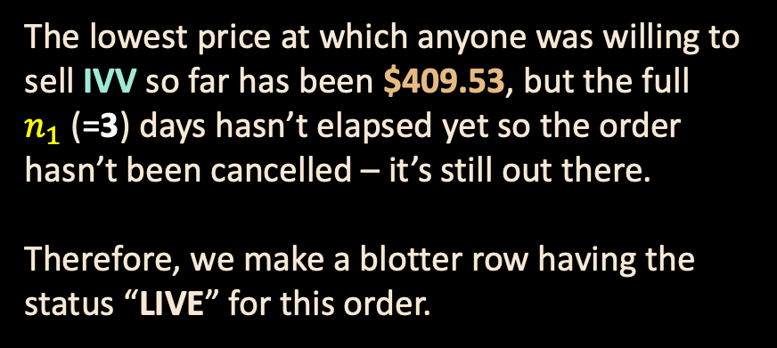
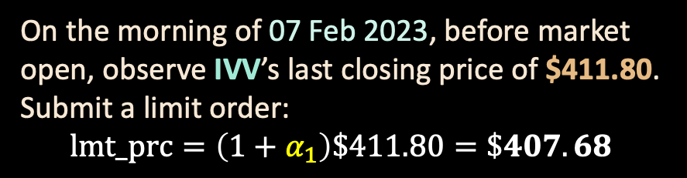
HW2: Example
Trade 6:
PARAMETERS
$$α_{1}=−1\%$$
$$n_{1}=3 \text{days}$$
On the morning of 07 Feb 2023, before market open, observe IVV’s last closing price of $411.80. Submit a limit order:
$$\text{lmt}\text{_}\text{prc}=\left(1+α_{1}\right)\$411.80=\$407.68$$
The lowest price at which anyone was willing to sell IVV so far has been $409.53, but the full $n_{1}$(=3) days hasn’t elapsed yet so the order hasn’t been cancelled – it’s still out there.
Therefore, we make a blotter row having the status “LIVE” for this order.
The blotter entries for Trade 6 would look like this

Slide 17
HW2
When I say “best way to complete”, I mean the best way I have found so far.
You may very well improve somewhat on this in terms of speed – if you do, great! Share it on Teams ☺
As always, report any errors you find on Teams!

Slide 18
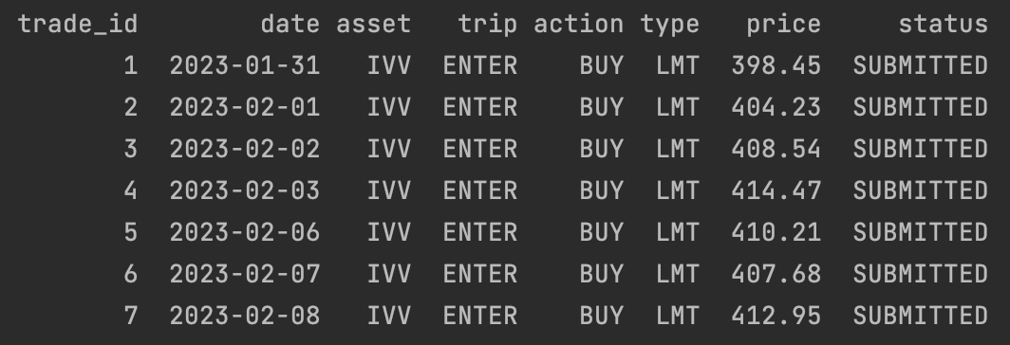
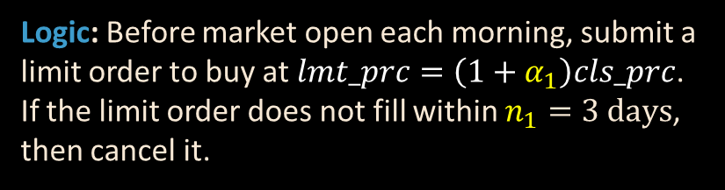

HW2: Best way to Complete
Logic: Before market open each morning, submit a limit order to buy at $lmt_prc=\left(1+α_{1}\right)cls_prc$. If the limit order does not fill within $n_{1}=3 \text{days}$, then cancel it.
PARAMETERS
$$α_{1}=−1\%$$
$$n_{1}=3 \text{days}$$
Step 1: Calculate submitted entry orders:

Slide 19
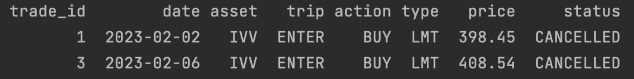
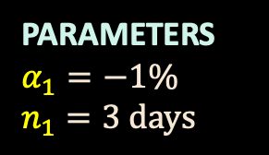
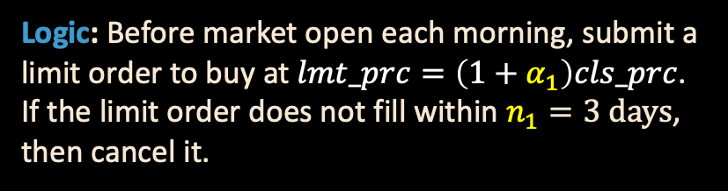
HW2: Best way to Complete
Logic: Before market open each morning, submit a limit order to buy at $lmt_prc=\left(1+α_{1}\right)cls_prc$. If the limit order does not fill within $n_{1}=3 \text{days}$, then cancel it.
PARAMETERS
$$α_{1}=−1\%$$
$$n_{1}=3 \text{days}$$
Step 2: Calculate cancelled entry orders:

Slide 20
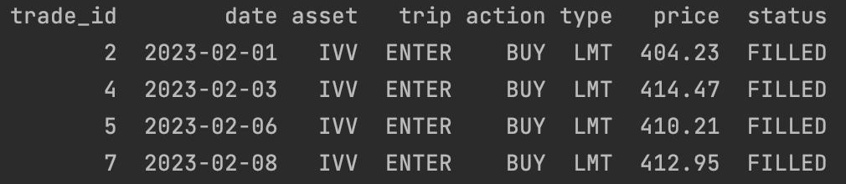
HW2: Best way to Complete
Logic: Before market open each morning, submit a limit order to buy at $lmt_prc=\left(1+α_{1}\right)cls_prc$. If the limit order does not fill within $n_{1}=3 \text{days}$, then cancel it.
PARAMETERS
$$α_{1}=−1\%$$
$$n_{1}=3 \text{days}$$
Step 3: Calculate FILLED entry orders:

Slide 21
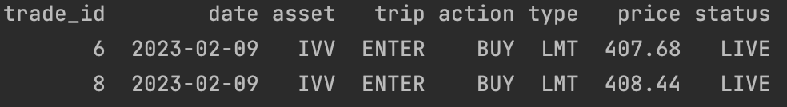
HW2: Best way to Complete
Logic: Before market open each morning, submit a limit order to buy at $lmt_prc=\left(1+α_{1}\right)cls_prc$. If the limit order does not fill within $n_{1}=3 \text{days}$, then cancel it.
PARAMETERS
$$α_{1}=−1\%$$
$$n_{1}=3 \text{days}$$
Step 4: If it was SUBMITTED but wasn’t FILLED or CANCELLED, then it must still be LIVE, so calculate those:
You can see here that I’ve chosen to include the next business day’s trade as LIVE. This way, you know that any order that is SUBMITTED but not LIVE must be a planned order for the future.

